Slide 1

Hospital Database
2019/12/06
Caique Bispo Ferreira
Chuyun Yang
Manal Hagos
Meera Mohan

Slide 2

Outlines
Introduction
CREATE TABLES
CREATE SEQUENCES
CREATE INDEXES
ER DIAGRAM
FUNCTIONS
PROCEDURES
TRIGGER
Web application
Conclusion,Q&A

Slide 3
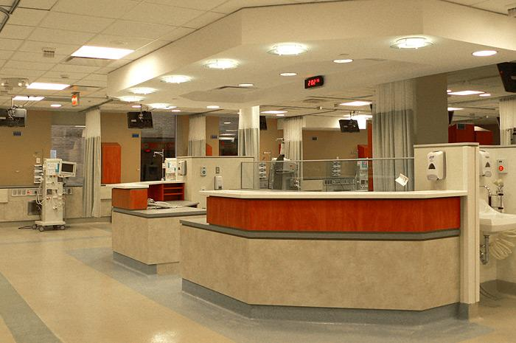
Introduction
Organize, control and manage the patients’ files
Provide a general perspective when doctors need to check any historic medical information.
Doctors to be more accurate in their prescription.
Provide a general overview of the patients’ life in hospitals or/and clinics.
Insurance companies can also use this data
to provide cheaper health insurance plans.

Slide 4
Create Table
There are basically 5 tables in our project . They are:
- DOCTOR,
PATIENT,
COMPANY,
COMPANYXPATIENT,
and PRESCRIPTION.

Slide 5
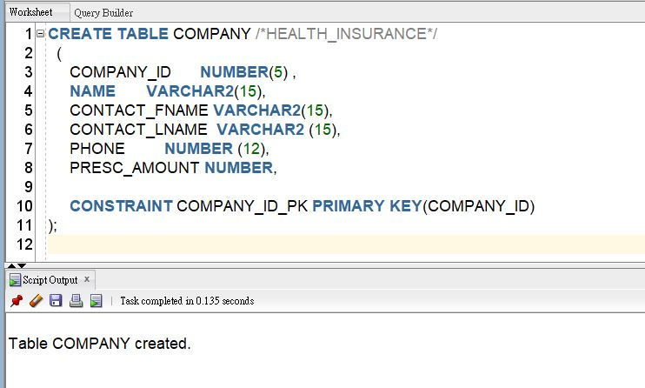
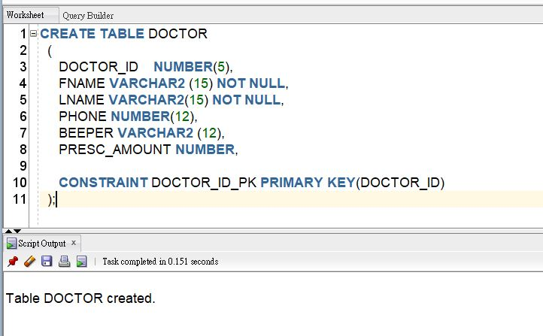
Create Table

Slide 6
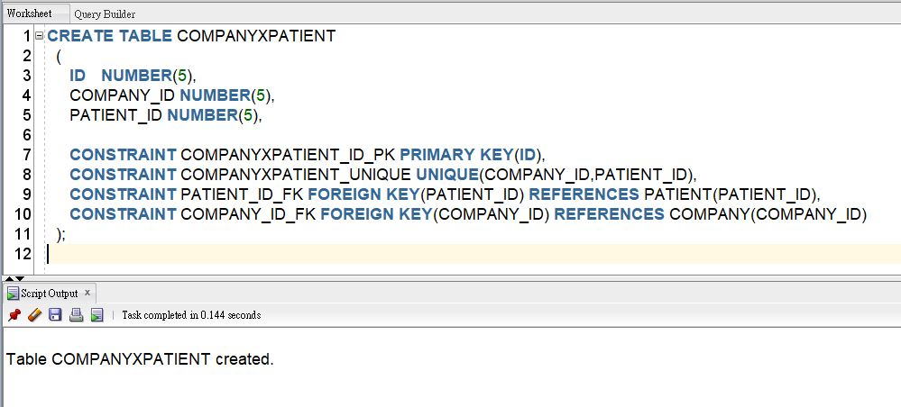
Create Table

Slide 7
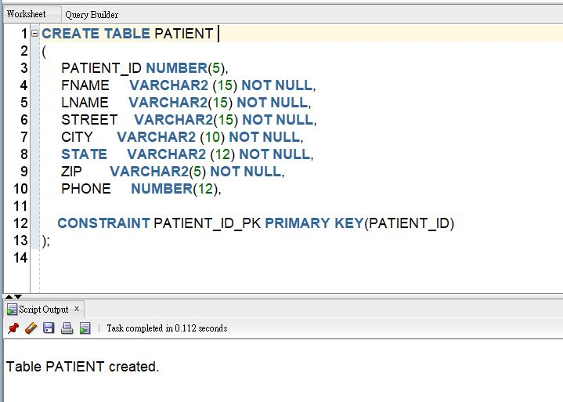
Create Table

Slide 8
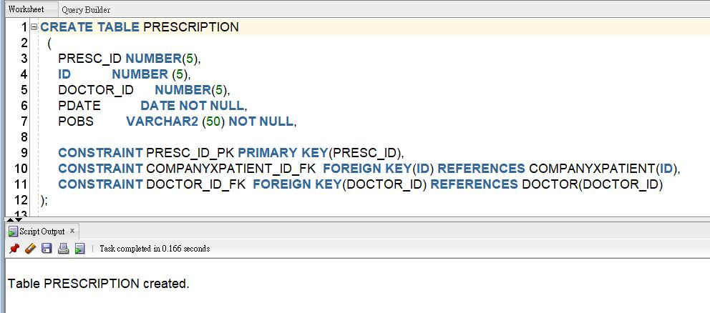
Create Table

Slide 9
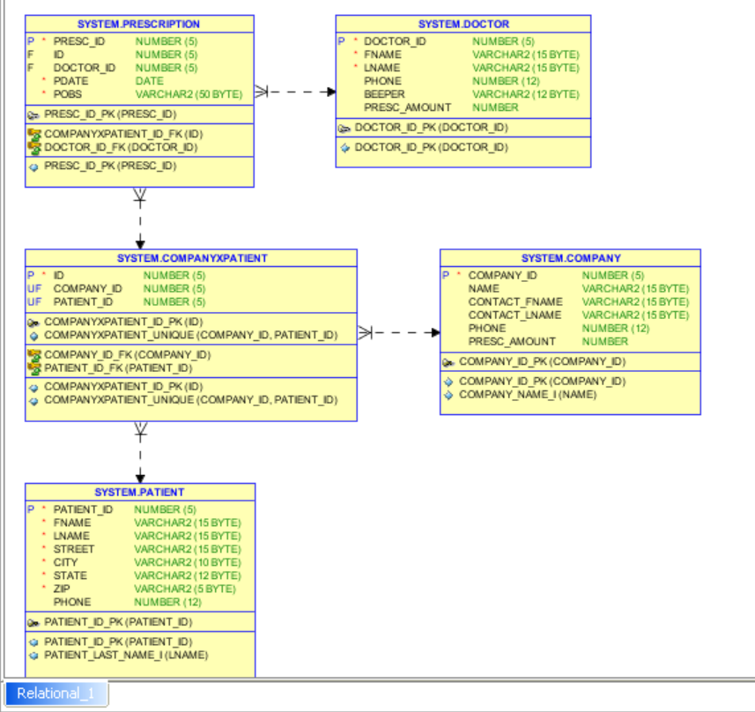
ER Diagram
It includes primary keys, foreign keys, sequences, indexes, constraints and cardinality.

Slide 10
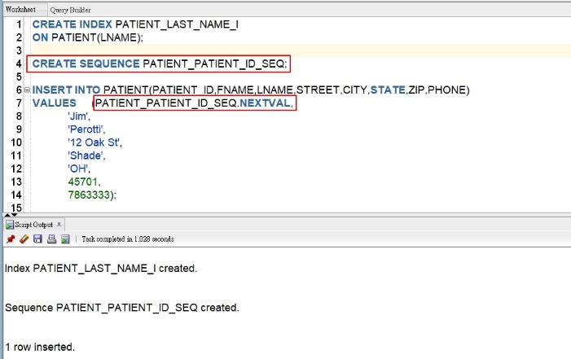
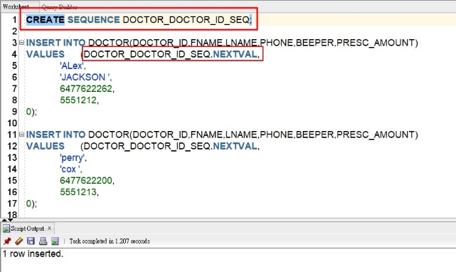
CREATE SEQUENCES
Each table has its sequence

Slide 11
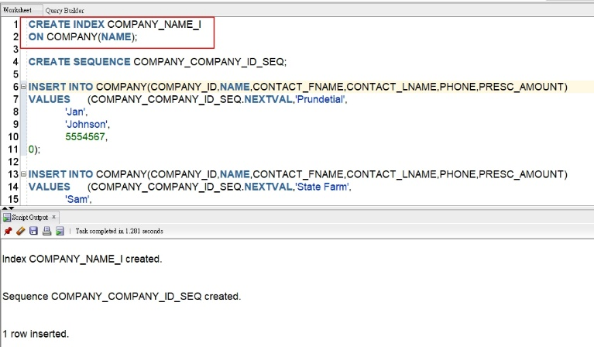
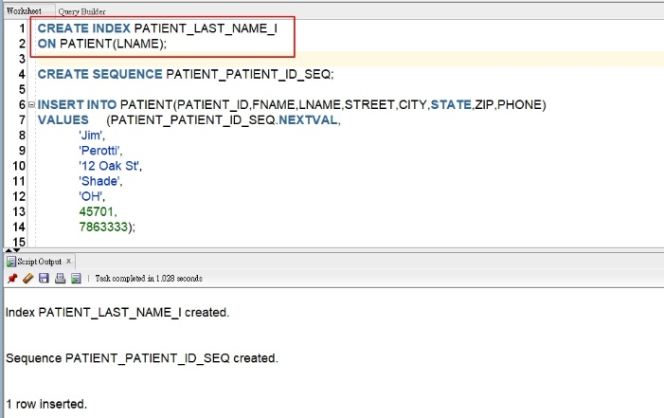
CREATE INDEXES

Slide 12
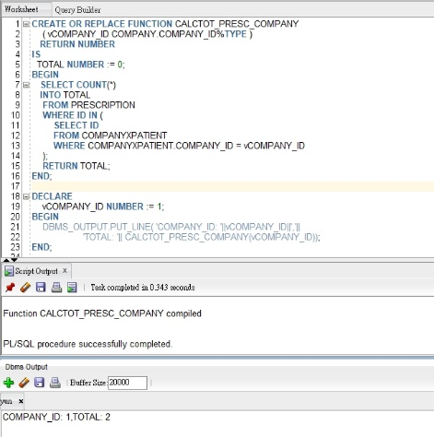

FUNCTIONS

Slide 13
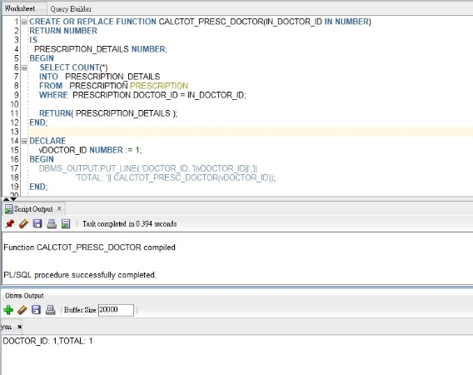

FUNCTIONS

Slide 14
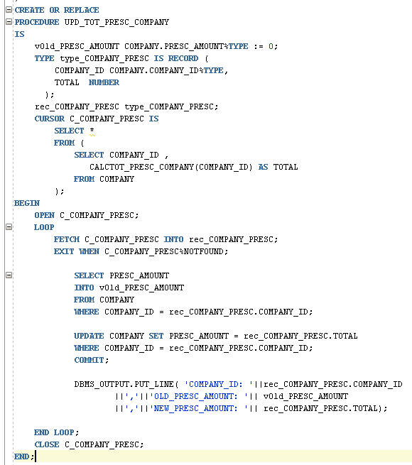
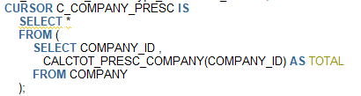
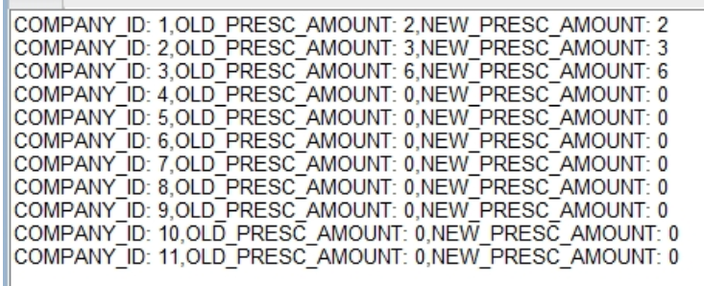
PROCEDURES

Slide 15
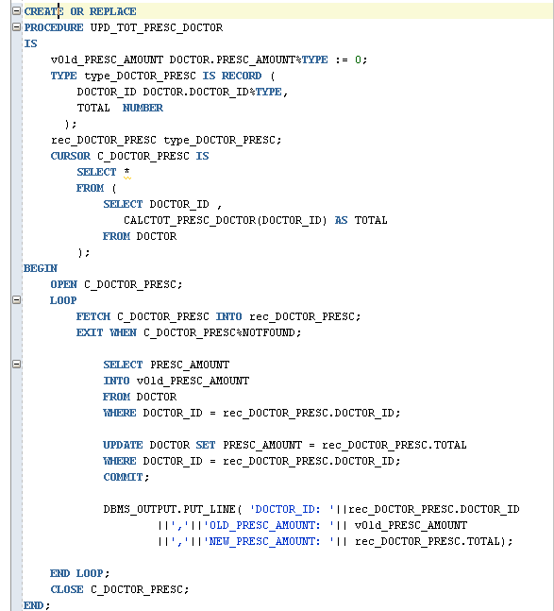
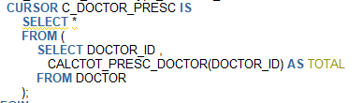
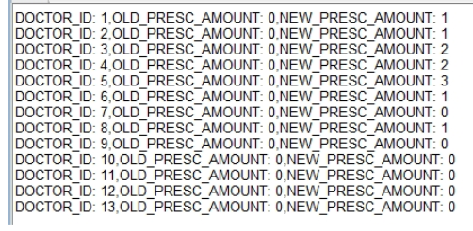
PROCEDURES

Slide 16
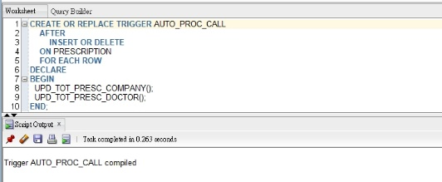
Trigger

Slide 17
Web Application
This project was developed using the following technologies:
Computer language: Java 8
Back-end framework: Spring Boot Framework 2.0.6
Front-end library: Bootstrap 4
Server application: Tomcat 9.0.26
Database: Oracle 11g

Slide 18
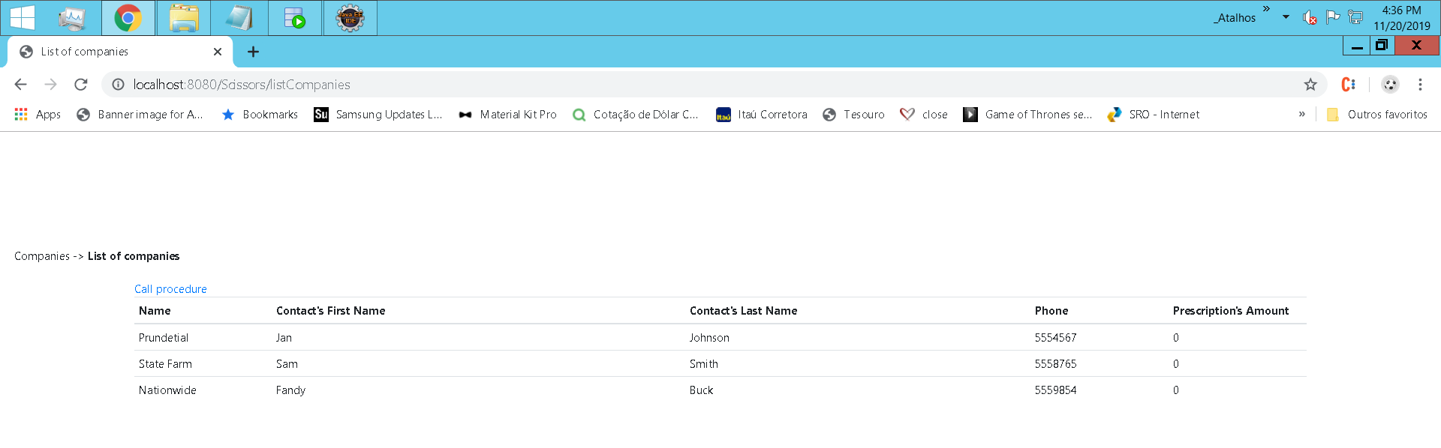
Web Application

Slide 19
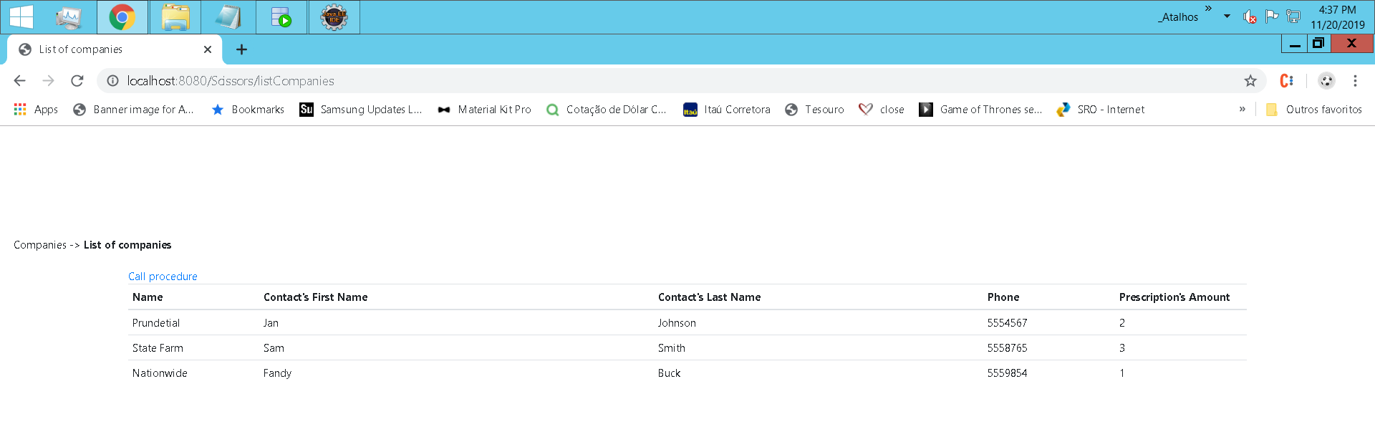
Web Application

Slide 20

Conclusion Q & A
Knowledge enhancement in Oracle database
Time management challenge and task prioritization
Autonomy of members in performing tasks

Slide 21
Thank You !

